Slide 1
Florida

Slide 2
AHRQ Culture of Patient Safety: Hospital
Survey contains: 32 core domain items
Survey period: September 3 - 30, 2024
10 core domains of hospital safety culture
Supervisor, Manager, or Clinical Leader Support for Patient Safety
Teamwork
Communication Openness
Reporting Patient Safety Events
Organizational Learning – Continuous Improvement
Communication About Error
Hospital Management Support for Patient Safety
Response to Error
Handoffs and Information Exchange
Staffing and Work Pace
3 additional measures
Overall Patient Safety Rating*
Number of Events Reported
Likelihood to Seek Care at this Hospital
Likelihood to Seek Care in this Unit
1 open-ended item
Response Options
Favorable |  | Neutral | Unfavorable
Agreement Response Scale
Strongly Agree | Agree | Neither Agree nor Disagree | Disagree | Strongly Disagree
Frequency Response Scale
Always | Most of the Time | Sometimes | Rarely | Never
Rating Response Scale
Excellent | Very Good | Good | Fair | Poor
% Favorable = Green
% Unfavorable - Orange and Red
Higher Percentage is Always Better
Year over Year Significance Testing using 2 proportion Z tests.
* primary outcome measure
** negatively worded items (scores and benchmarks) are reversed-coded so that high favorability (teal) is always desired

Slide 3
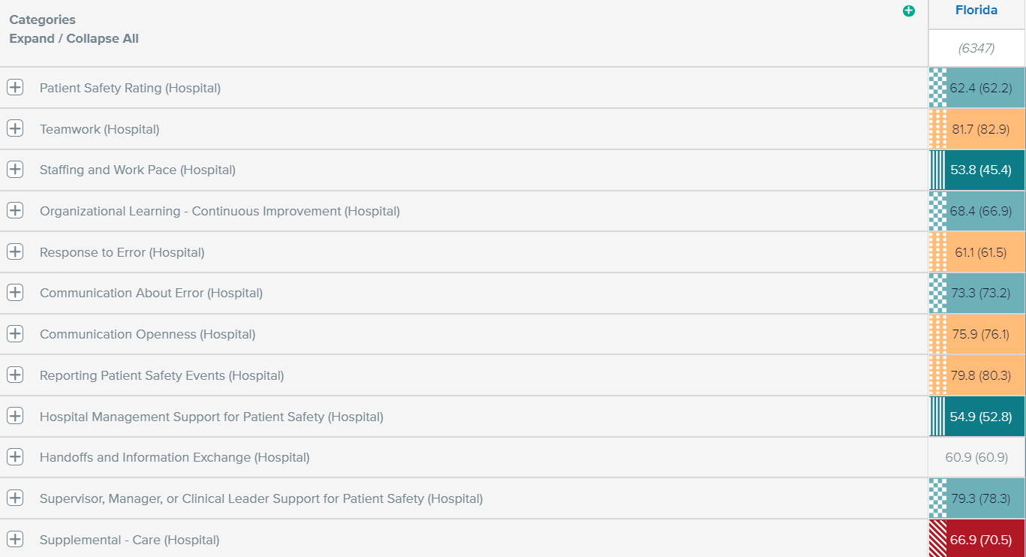
Florida - Market Performance
7 Individual Items with Significant Improvement
4 Individual Items with Significant Decline

Slide 4

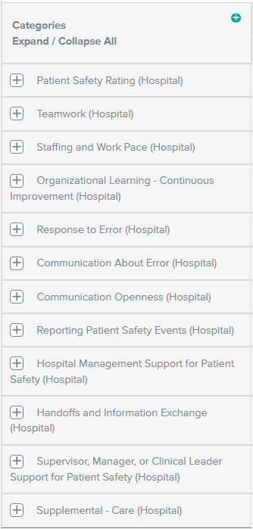
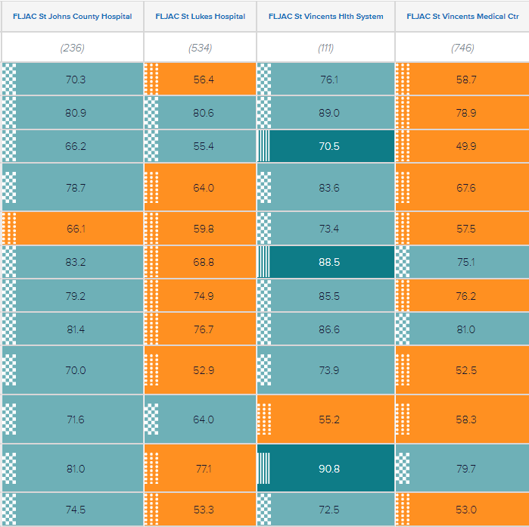
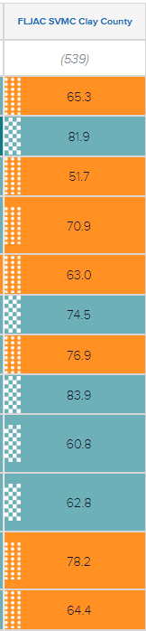
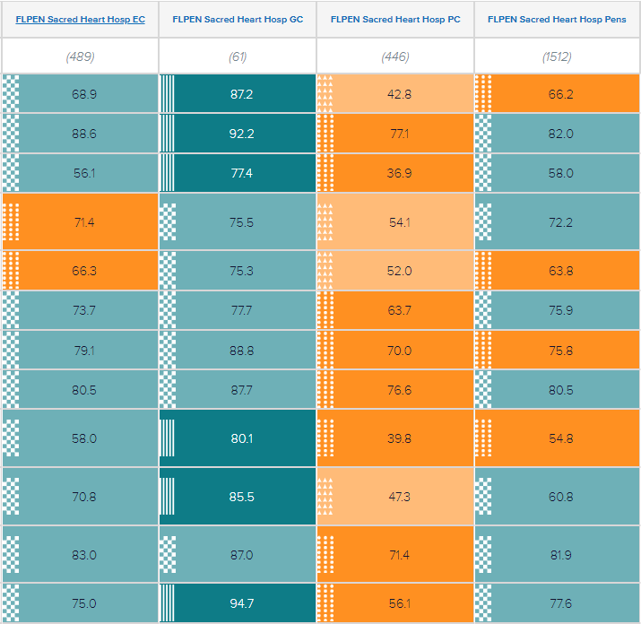
Florida - Hospital percentile performance within Ascension
Notes:
Overall percentile performance amongst Ascension Hospitals by category.

Slide 5

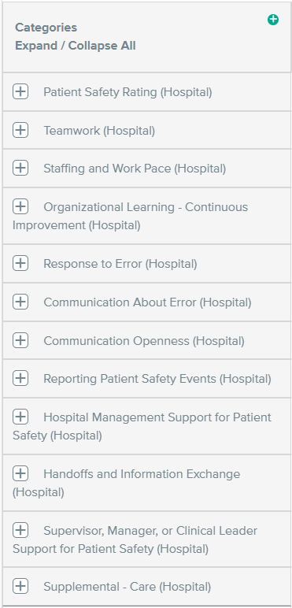
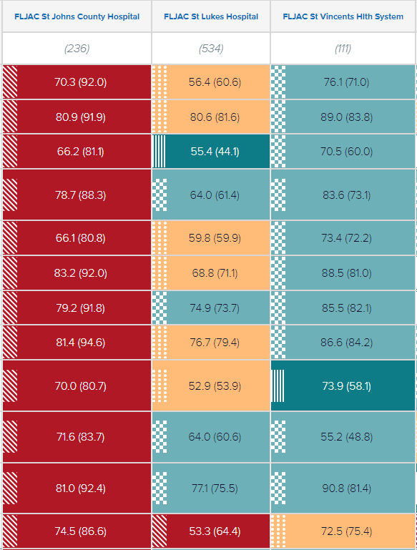
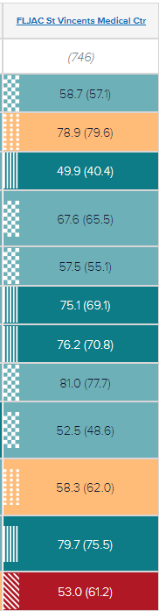
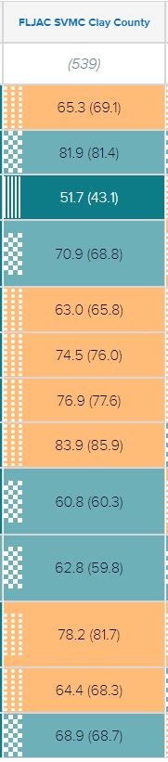
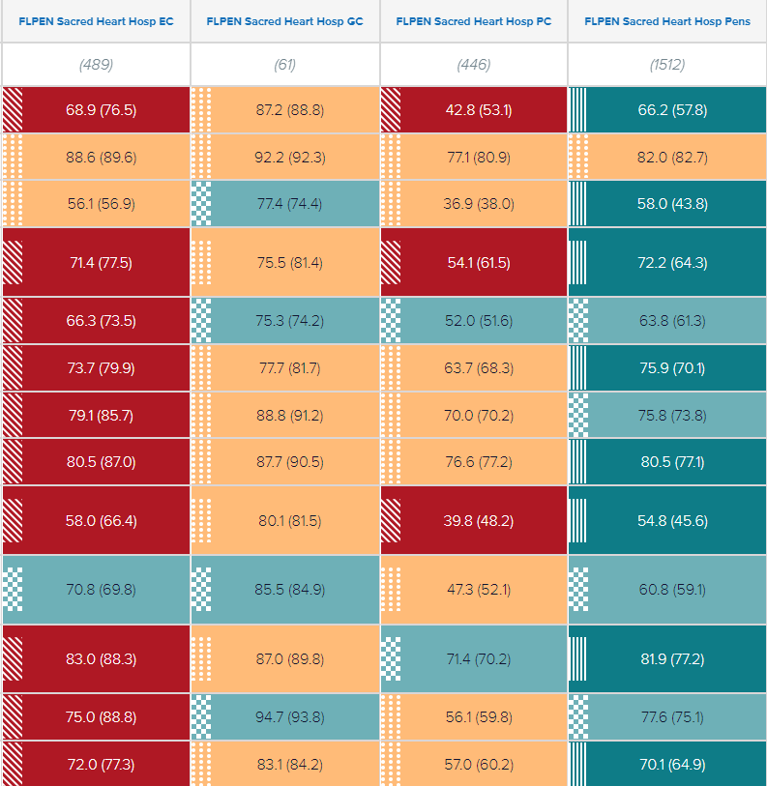
Florida - Compared to 2022 results by Category
Notes:
Significance of change by hospital by category as compared to the hospitals 2022 results

Slide 6
Florida
Top 5 Favorability | 2024 | 2022 | Ascension | AHRQ Bench 50th %
In this unit we work together as an effective team. | 88.3 | 88.5 | 86.9 | 88
During busy times, staff in this unit help each other. | 88.4 | 88.2 | 87 | 87
My supervisor, manager, or clinical leader takes action to address patient safety concerns that are brought to their attention | 82.5 | 81.7 | 84.8 | 84
In this unit, staff speak up if they see something that may negatively affect patient care. | 83.5 | 83 | 81.9 | 84
When a mistake reaches the patient and could have harmed the patient, but did not, how often is this reported? | 85.6 | 86.6 | 83.6 | 83
Bottom 5 Favorability
In this unit we have enough staff to handle the workload | 52.6 | 40.2 | 45.1 | 44
Staff in this unit work longer hours than is best for patient care. | 49.9 | 45.2 | 45 | 47
The work pace in this unit is so rushed that it negatively affects patient safety | 55.5 | 50.7 | 51.5 | 60
Hospital management seems interested in patient safety only after an adverse event happens | 36 | 35.6 | 34.4 | 47
When transferring patients from one unit to another, important information is often left out. | 51.3 | 51.6 | 49.6 | 55

Slide 7
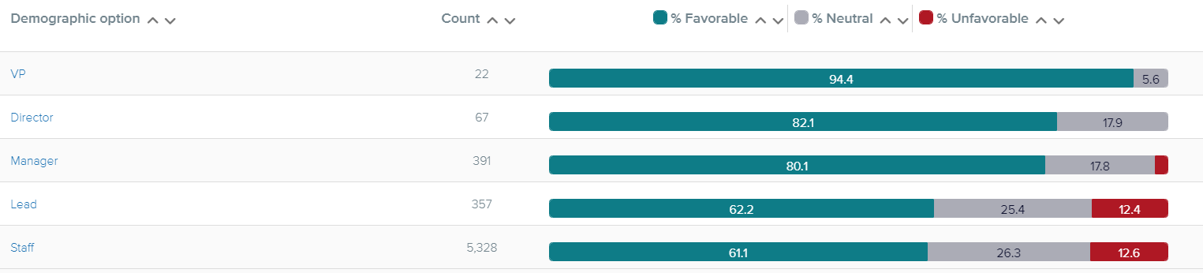
Florida Market - Patient Safety Rating as Perceived by “Level”

